Slide 1




Slide 2

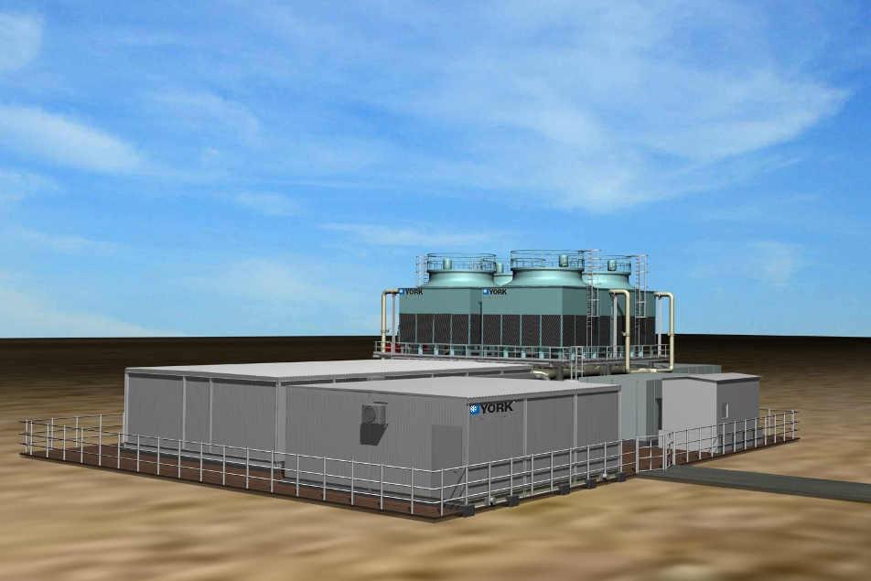
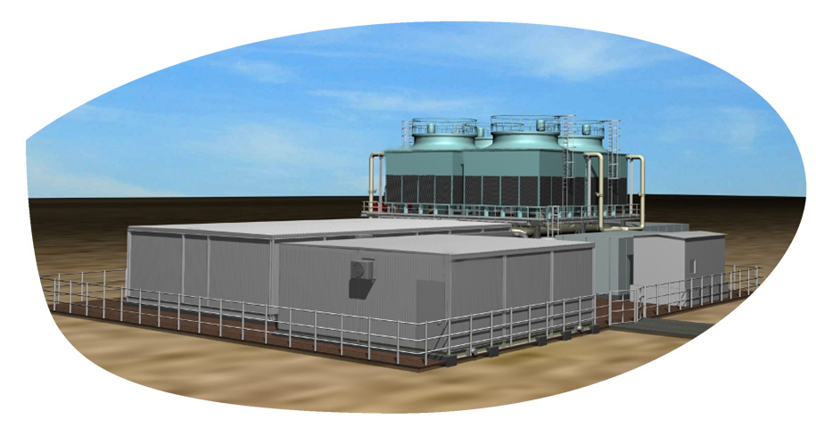


Flo Fab Enrgistx Modular chilling package Solutions

Slide 3
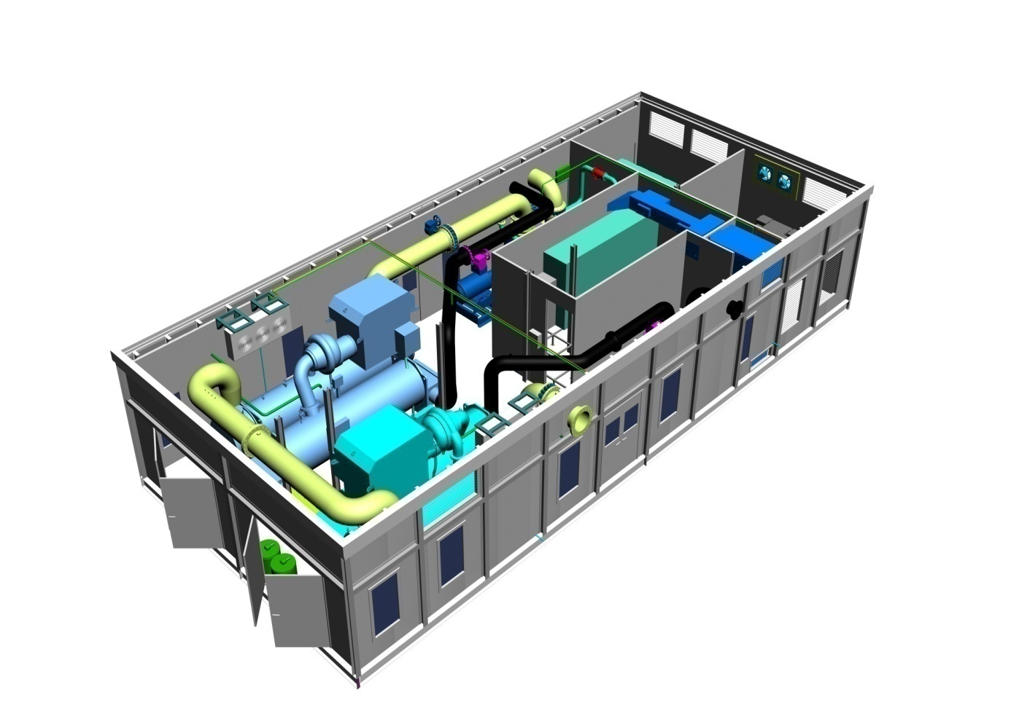
Agenda
What is a Packaged Plant ?
Benefits to Customer
The Flo Fab / Enrgistx Advantage
The Manufacturing Facility in Canada
What we DON’T Offer

Slide 4
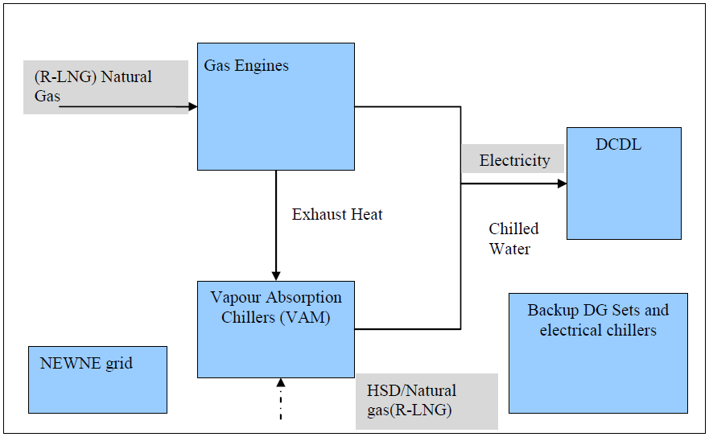
Full cycle

Slide 5
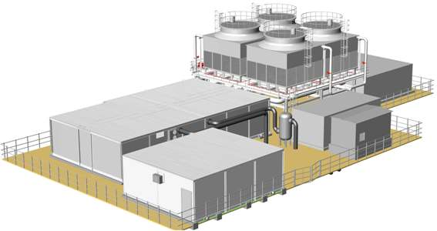
What is a Packaged Plant ?
A ‘packaged’ plant is a pre-designed factory assembled self-contained system shipped in modules for assembly at site.
It contains Gas Engine, Generator , chillers, cooling towers (Water cooled systems), instrumentation, controls, pumps, pipework, electrics
and all that is necessary for
producing chilled water.
Packaged plants can be
pre-engineered for the
majority of chiller
plant applications to
customer specification.

Slide 6
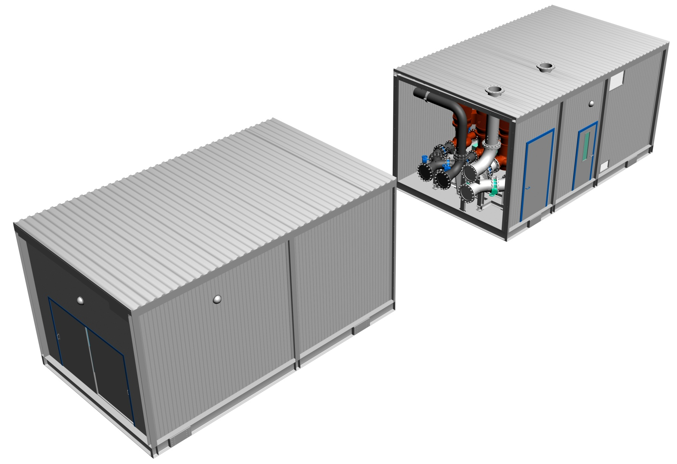
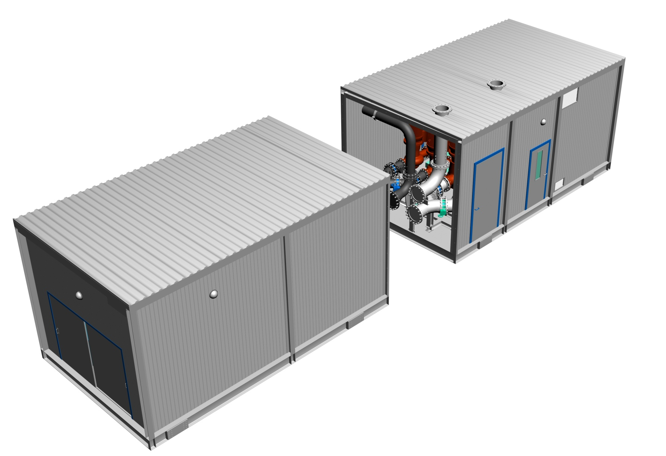
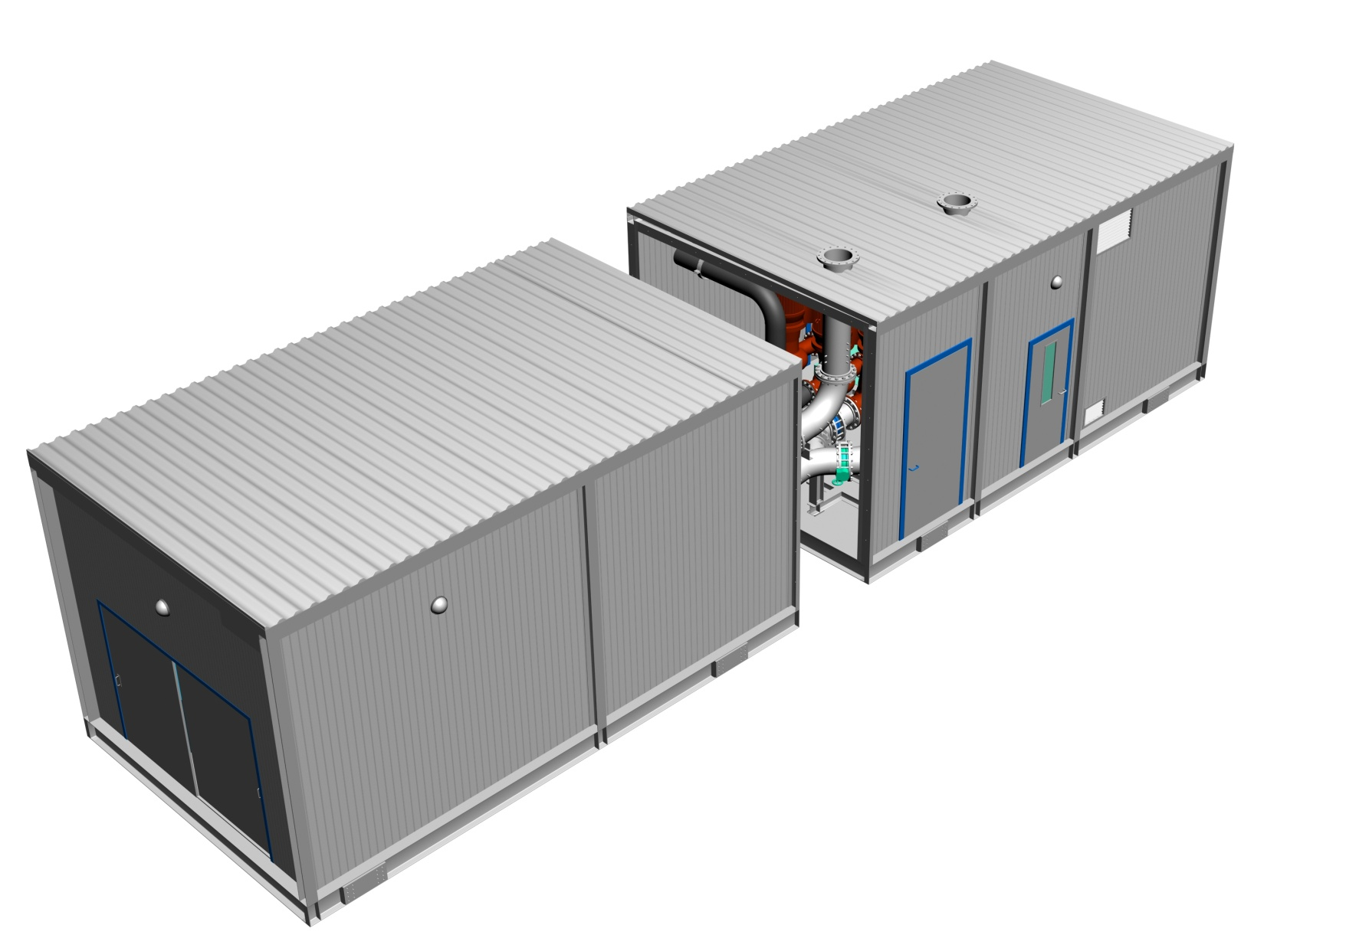
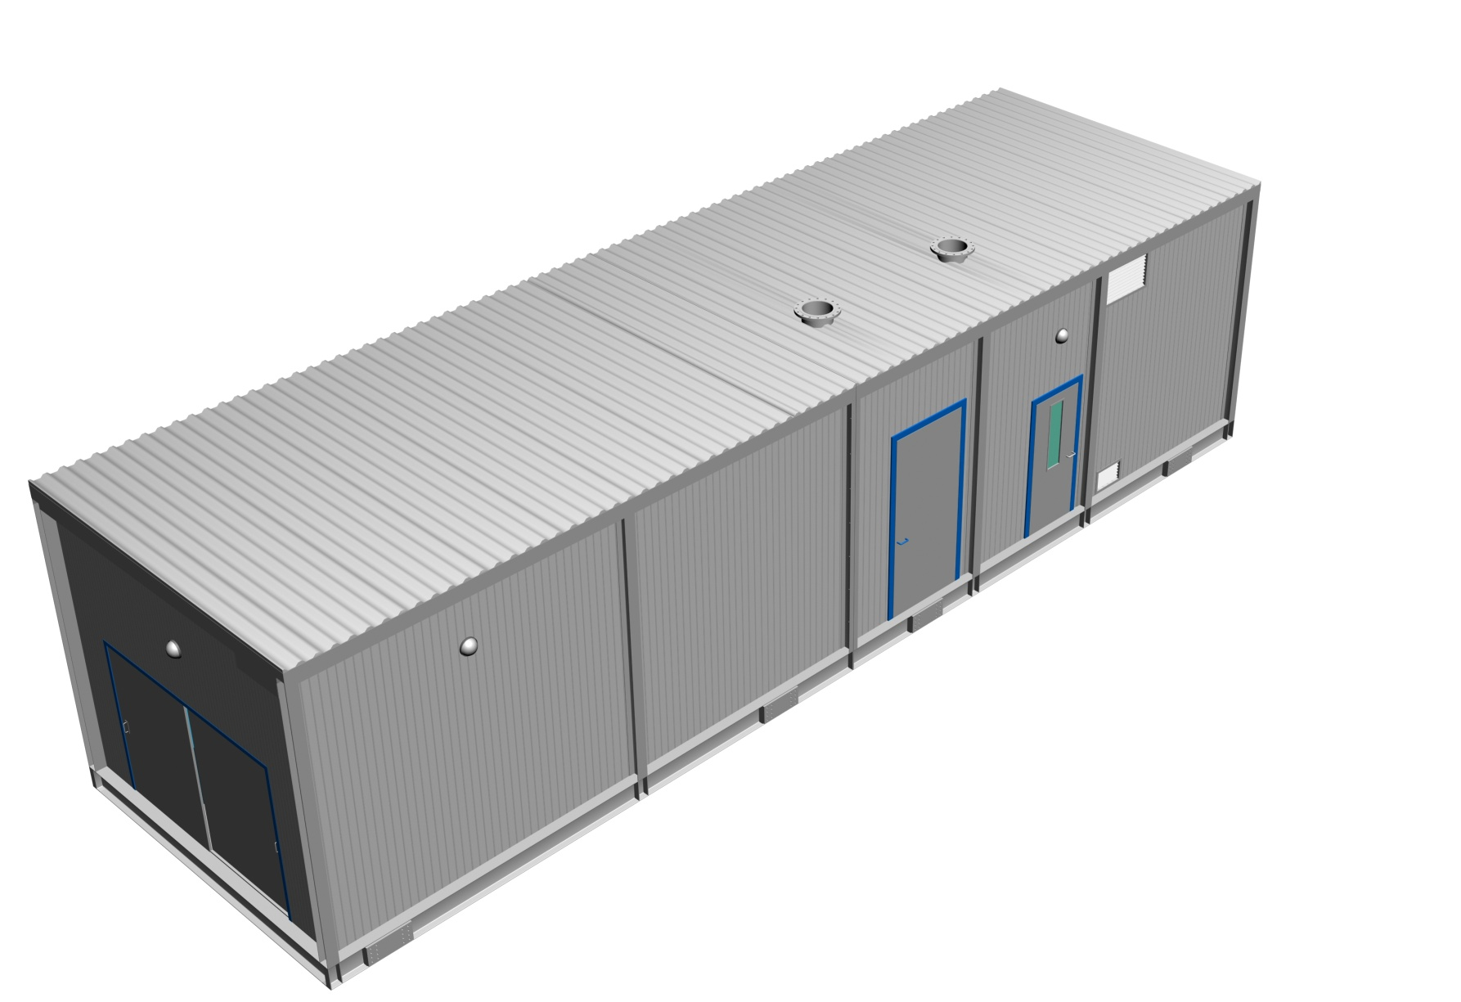
Split

Slide 7
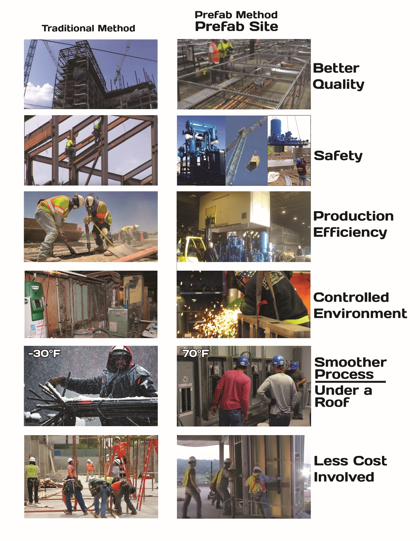


Slide 8
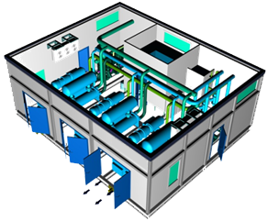
The MOST ENVIRONMENTAL FRIENDLY solution
Clean Electric generation engine (Gas) = Less Emission
NO Power losses from transmission lines = Less Emission
NO Refrigerants with Global Warming / Greenhouse effect refrigerants in the Main chiller.
No Refrigerants with Ozone layer depletion effect in the main chiller.
BEST FULL CYCLE CoP & LOWEST CARBON FOOTPRINT

Slide 9
Benefits to Customer
The most effective Total cost of ownership
Complete self-contained factory built CCHP Plant inclusive of all components necessary for reliable and efficient operation
Single point of responsibility - design, assembly & commissioning of packaged plant by Flo Fab enrgistx Helps avoid coordination issues - improves project management
High system energy efficiency – smaller carbon footprint / "green" performance.
Standard high quality as plant is manufactured in controlled factory environment by a certified team working to standard work procedures

Slide 10
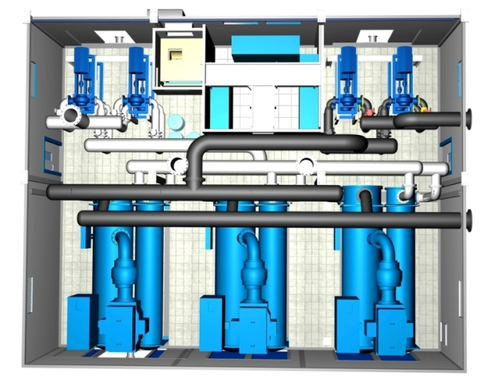
Benefits to Customer
Guaranteed performance - engineered, manufactured & commissioned by single entity.
Greater flexibility – affords scalability in case of phased construction
Reduced job site risk & EHS problems due to greatly reduced site work
Significantly smaller space requirement
Reduced construction schedules – improved project management. Manufacture of plant can continue in the factory while site approvals are still underway
Emergency solution in case of disasters & Catastrophes

Slide 11
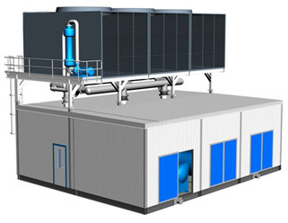
Benefits to Customer
Reduced contingency costs due to lesser site exposure & better project management
Minimum & simple site tie -ins such as chilled water piping connections, cooling tower make-up & drain connections, incoming electric power, earthing etc
Possible to relocate in case of future site development
In short – it is a WINNING PROPOSITION !!!

Slide 12
Skid Advantages
- Solution for both : New construction and Retrofit.
- Easily add more modules for future expansion.
- One single point of Responsibility / Contact .
- One single submittal for approval Vs. Individual ^{submittals for each component.}
- Financial : Cost reduction, Effectively reduce total cost of ownership for all project stake holders (Contractor / Consultant Engineer / End User)
- Financial : Space saving due to optimized space utilization.
- Financial : Time (Cost) saving : Skid built in parallel during building construction, also .
^{- Financial : Cash flow} management: One single invoice / payment for all ^{works}
^{- Financial :Overhead} saving including project management, logistical
coordination, insurance expense, ...etc.
- Financial : No surplus or extra components left after fabrication by contractor.
- Time (Cost) saving : No construction delay due to missing one single component order, wrong delivery or defective component.
- Quality: Assembly within controlled environment by certified technicians / welders using approved work ^{methods / procedures.}
- Quality / Financial : Factory wired and tested = site plug & play
- Safety: Avoid unpleasant site safety incidents and lost days as we tremendously minimize job site man-hours.

Slide 13

The Flo Fab Enrgistx Advantage
Engineering & Manufacturing Setup in North America
Optimized Equipment and Controls Selection & Design
Different options Generators & Chillers
Global Sourcing Agreement with reputed suppliers for other major components
Excellent After Market Service & Spares Setup

Slide 14
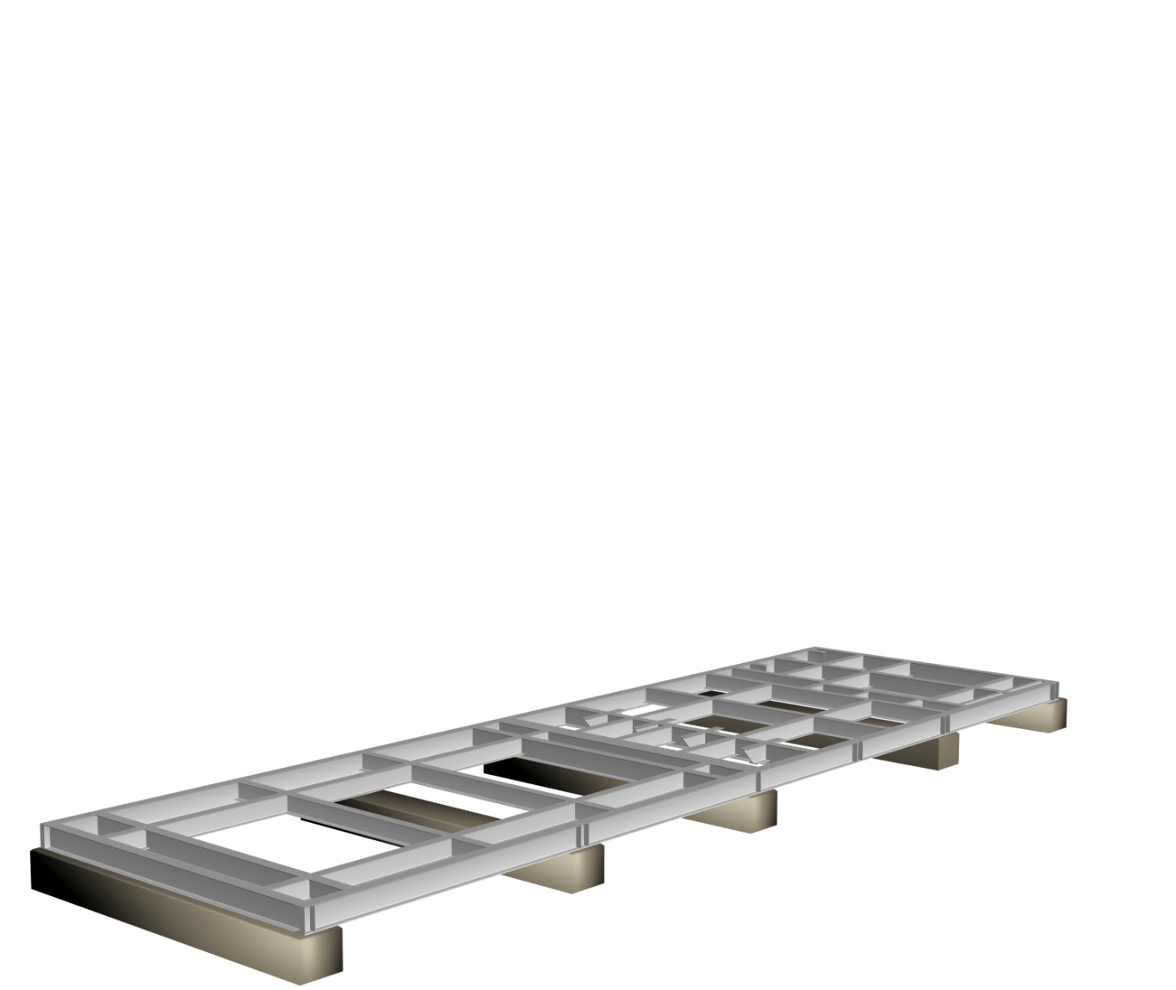
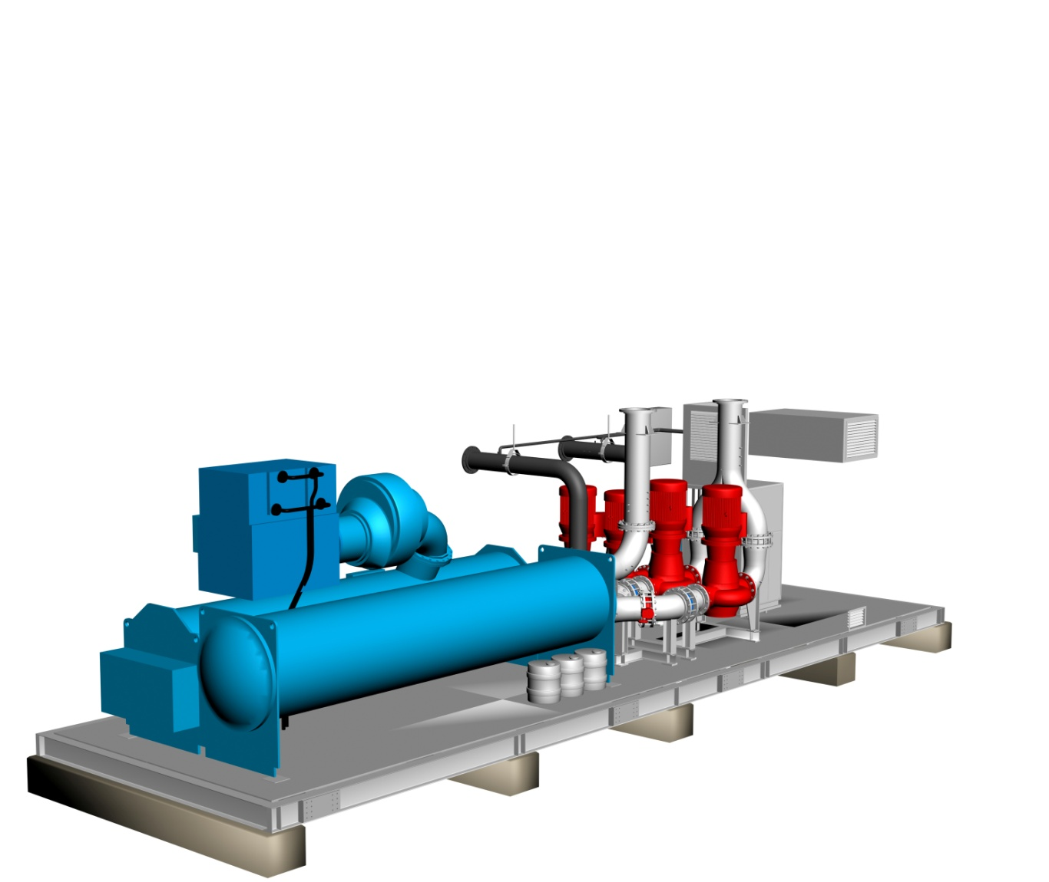

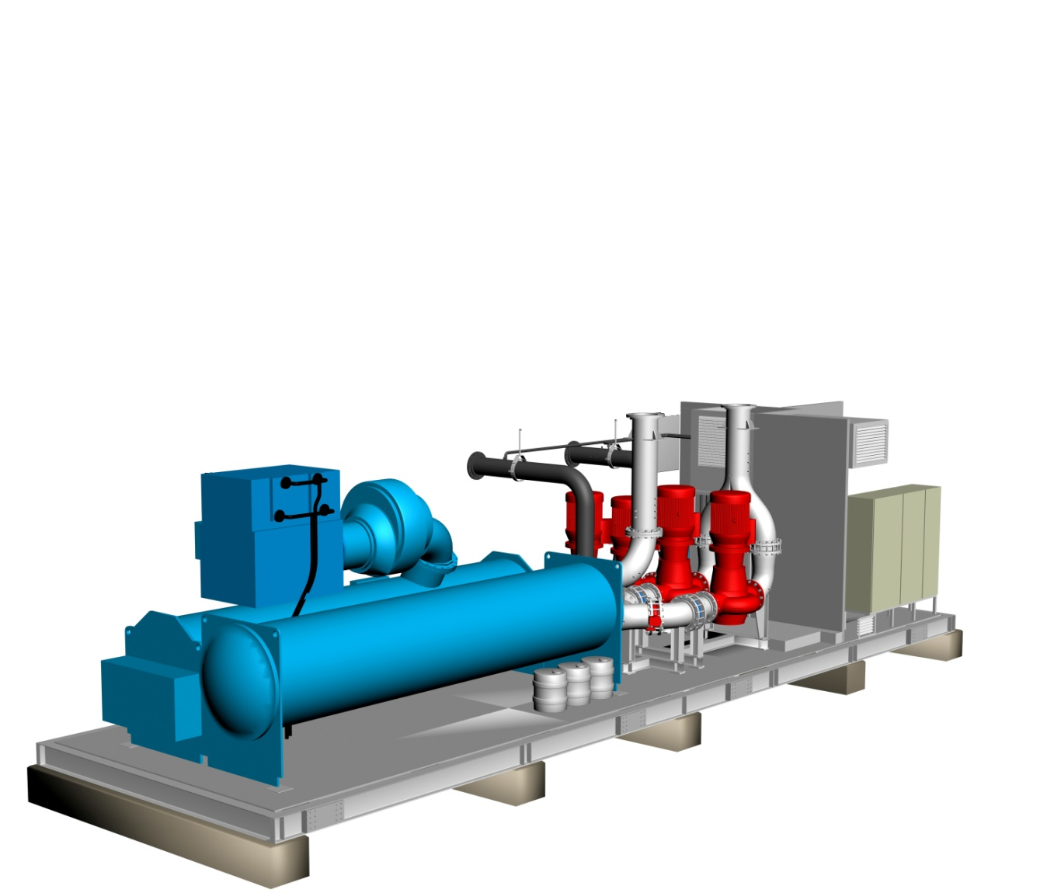
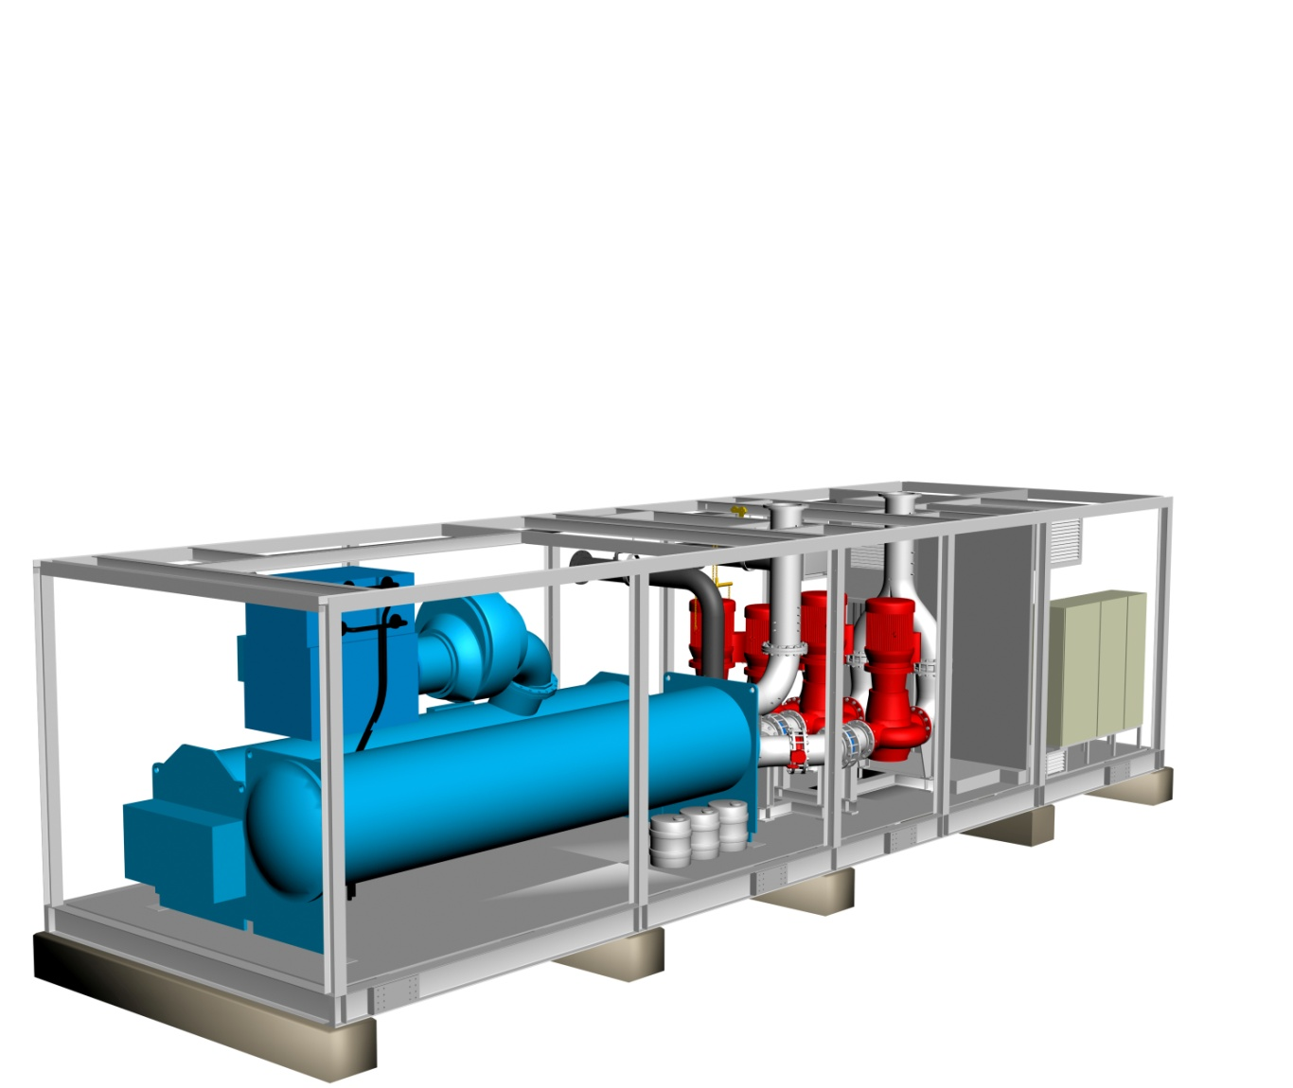
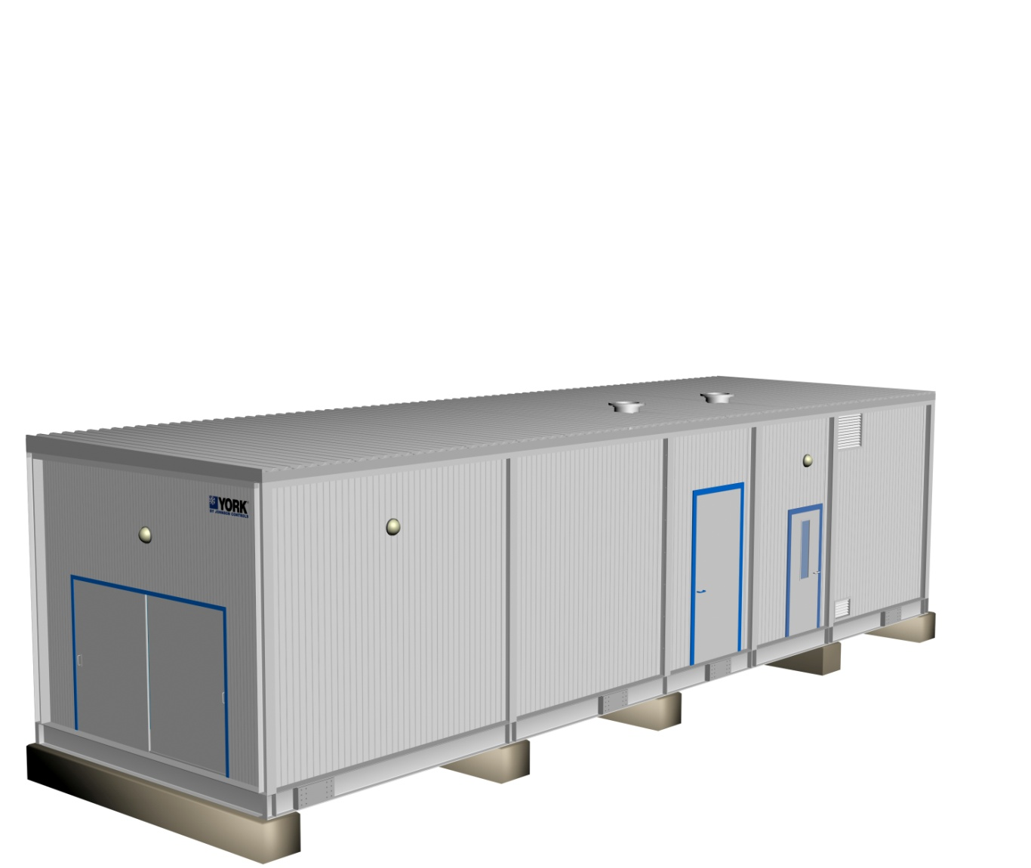
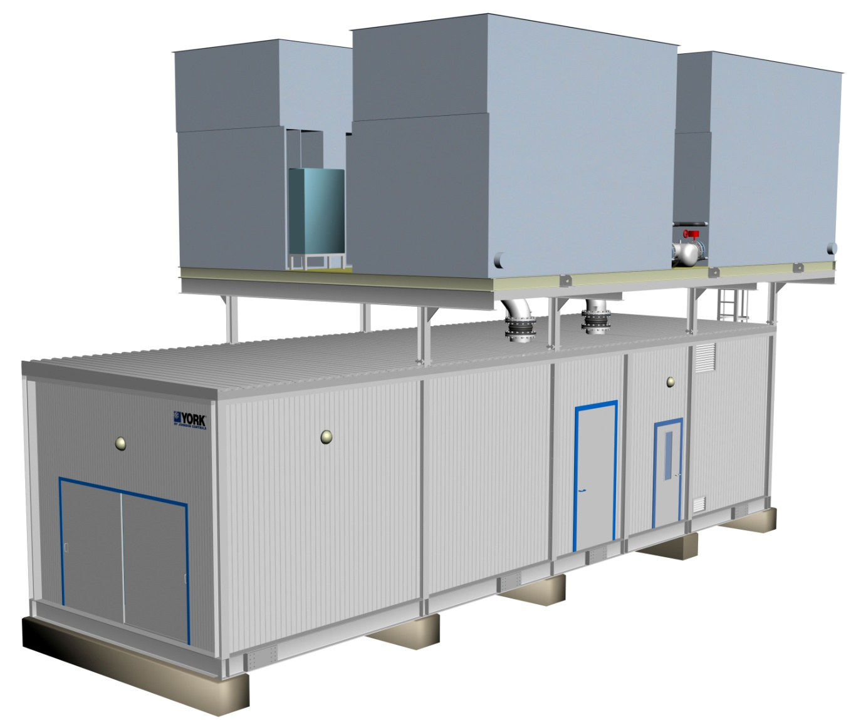
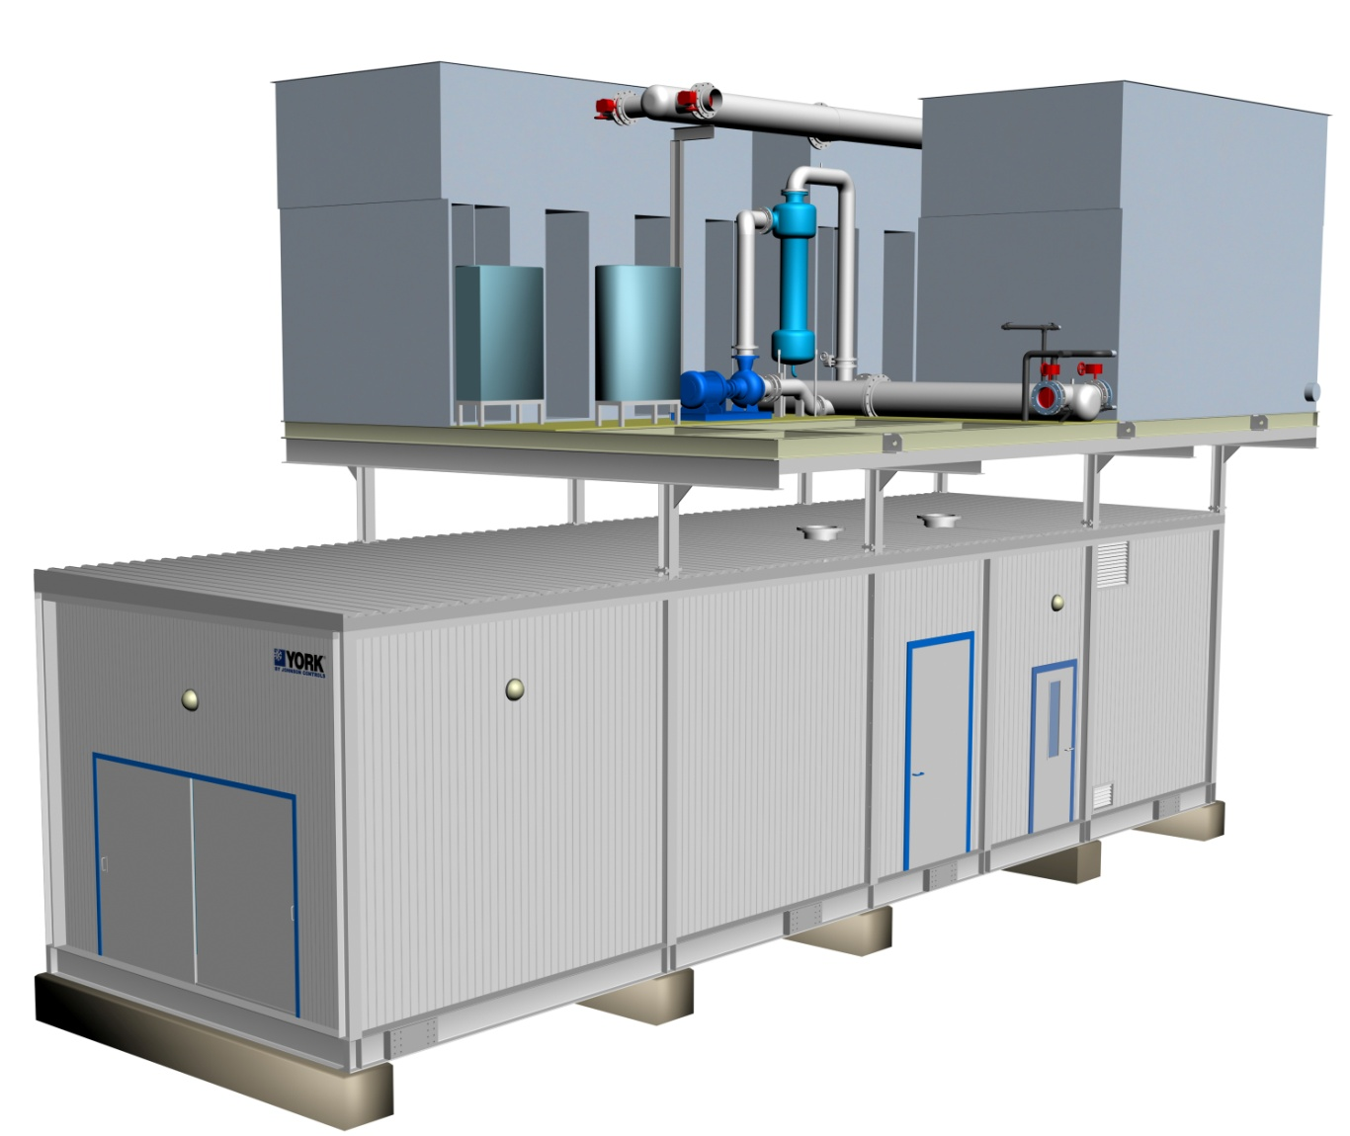

Modularized Packaged Chilling System
Produced within Controlled Environment :
    Manufactured, Not Constructed
    Proven Engineered Design and Fabrication Standards
    Strict Quality Control
    Controlled Environment with High Safety Standards
    Established Knowledgeable Skilled Workforce
    Job Site Progress / Conditions Irrelevant to Production
Notes:
14

Slide 15
Applications
Turbine Inlet Air-cooling
Industrial applications
Any process with thrown heat (Hot water / Steam) to be recovered
Immediate power supply
Constant Volume Chilled Water Circuits
Primary-Secondary
Variable Primary
High delta T
Permanent Plant
Temporary (Portable) Cooling & Rental
Long Term Temporary Plant

Slide 16
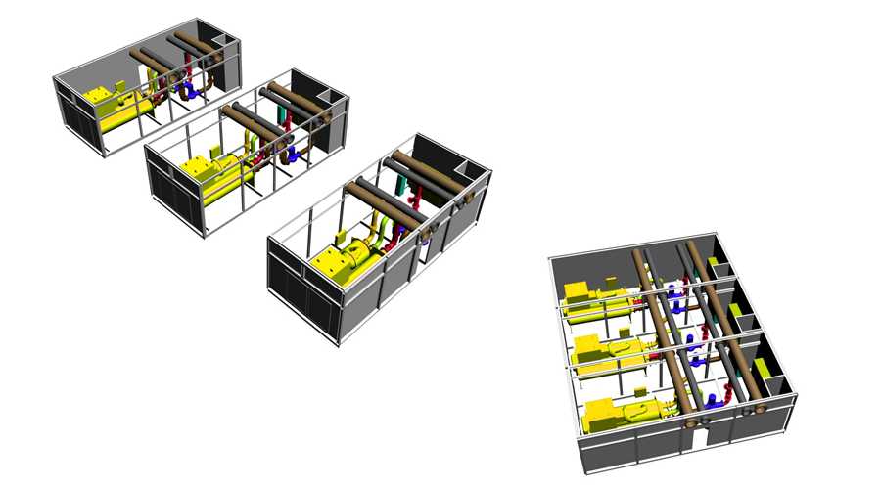
Multiple Units

Slide 17

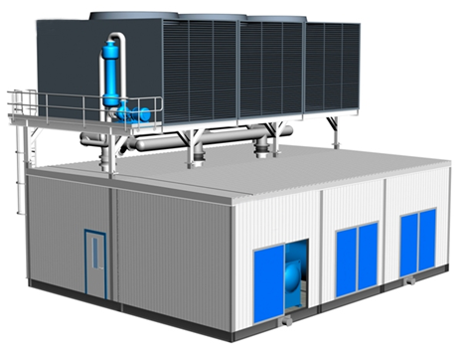
Multiple Units

Slide 18
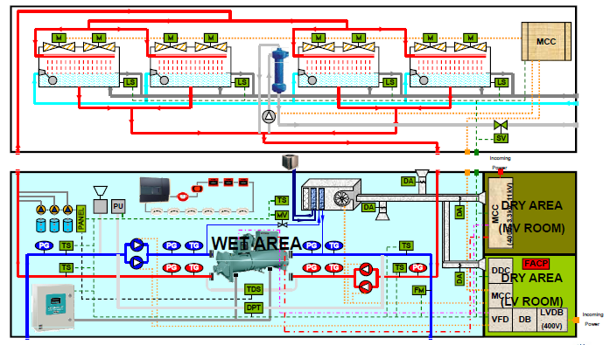
Piping & Instrumentation Diagram P&ID

Slide 19
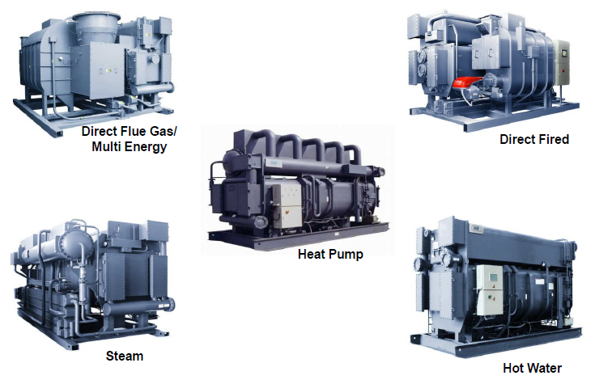
Absorption Chillers (Water-Cooled)

Slide 20
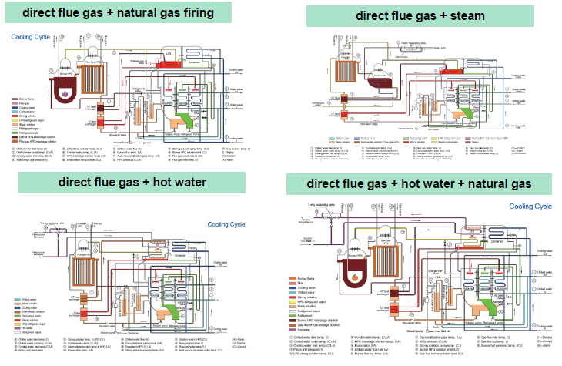
Absorption Chillers (Multi Energy)

Slide 21
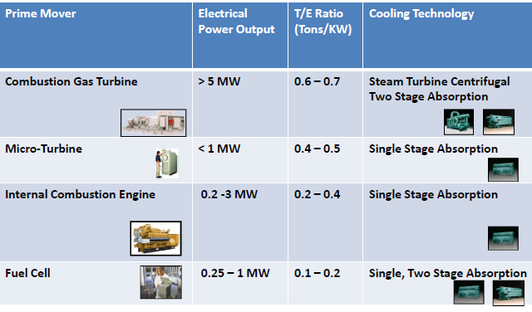
Absorption Chillers (Thermal - Electric Ratio)
TO BE UPDATED

Slide 22
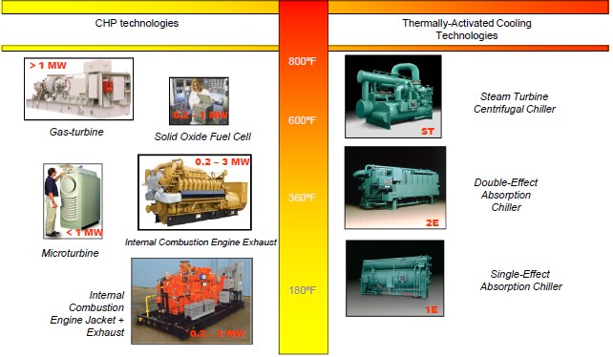
Absorption Chillers (CHP – Thermally activated cooling technologies)
TO BE UPDATED

Slide 23
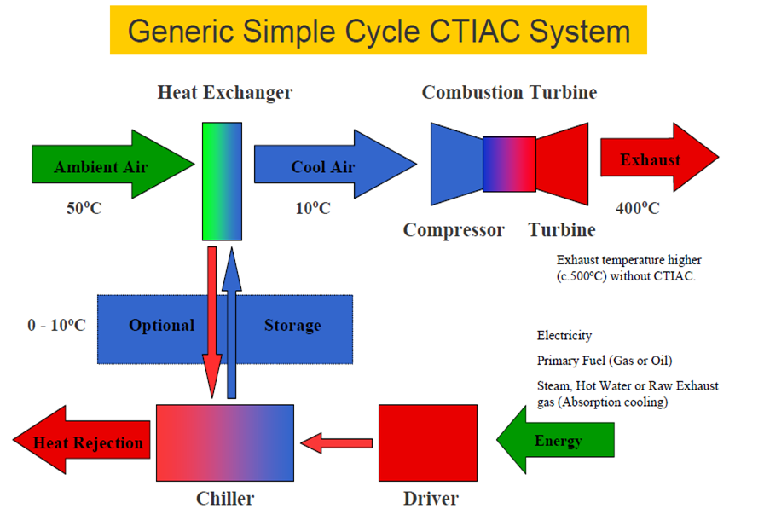
Absorption Chillers / CTIAC

Slide 24
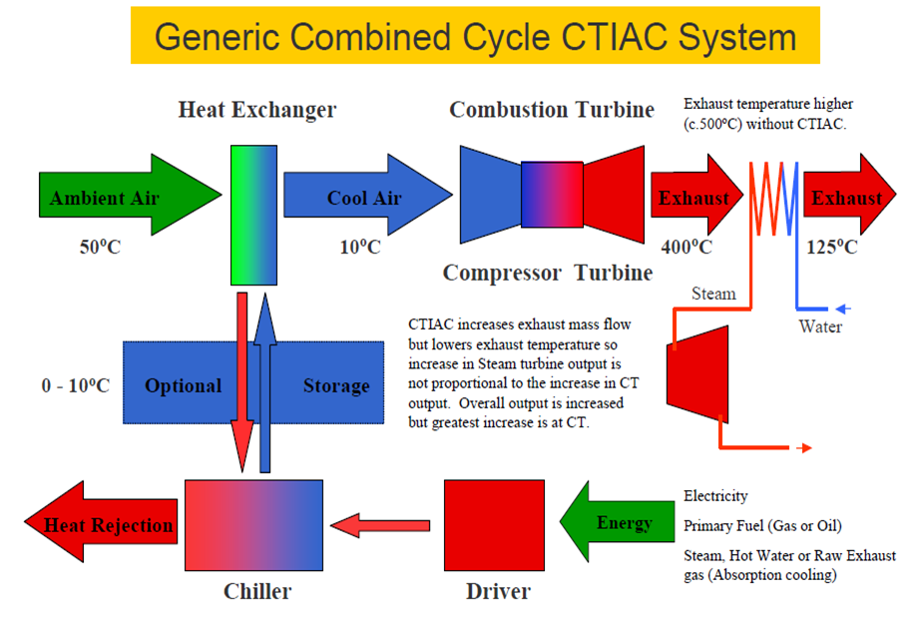
Absorption Chillers / CTIAC

Slide 25
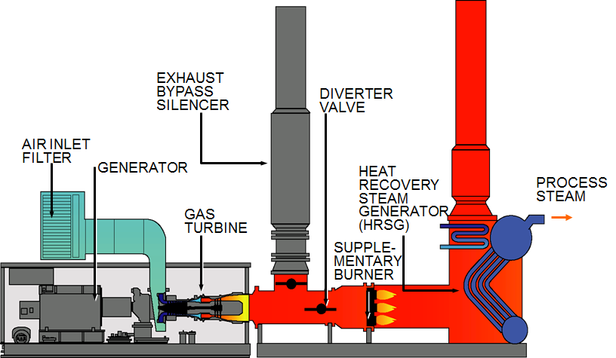
GT CHP System
Generator/HRSG System
Source: Solar Turbines

Slide 26
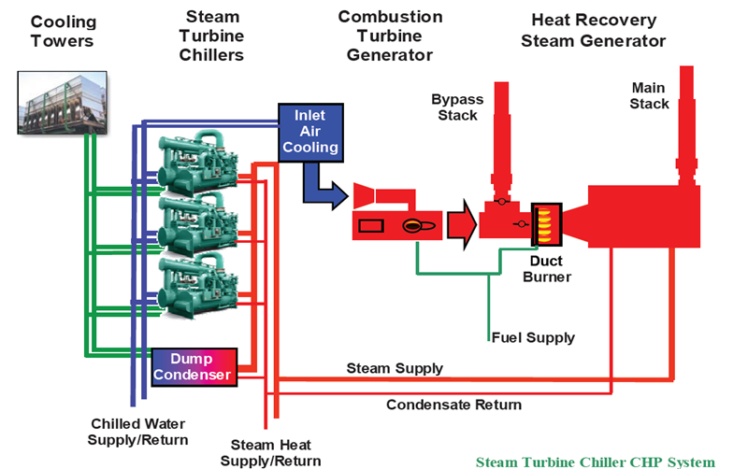
Turbine Inlet Air-cooling with Absorption
TO BE UPDATED

Slide 27
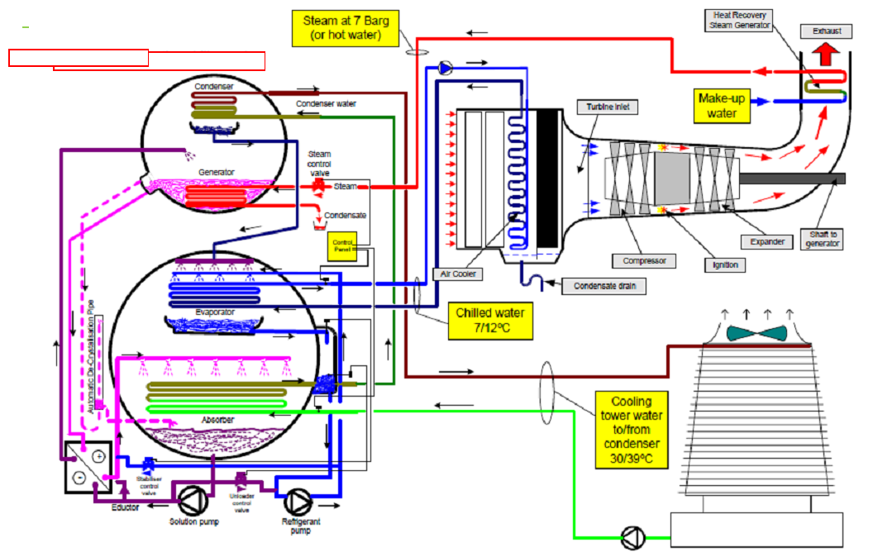
Simplified Absorption Refrigeration System

Slide 28
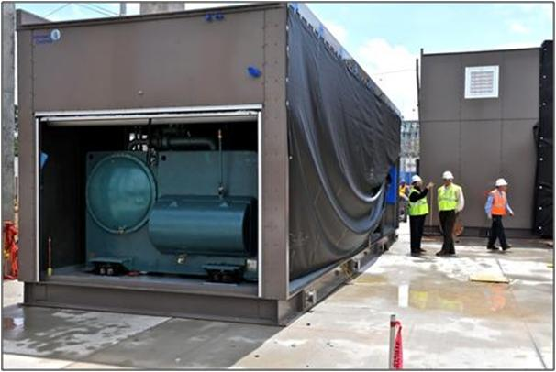
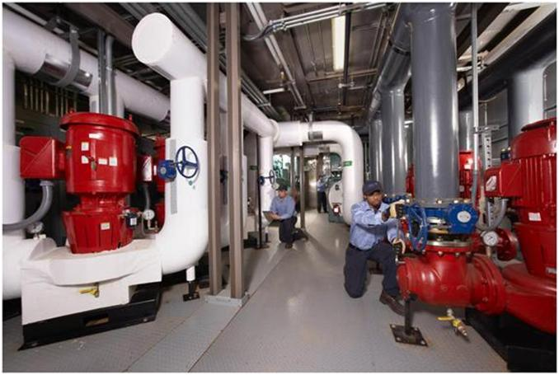
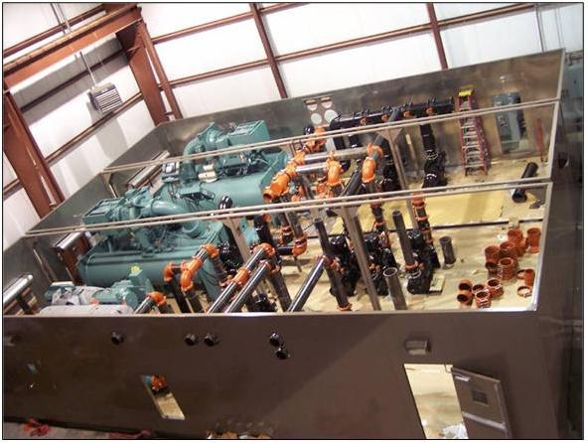
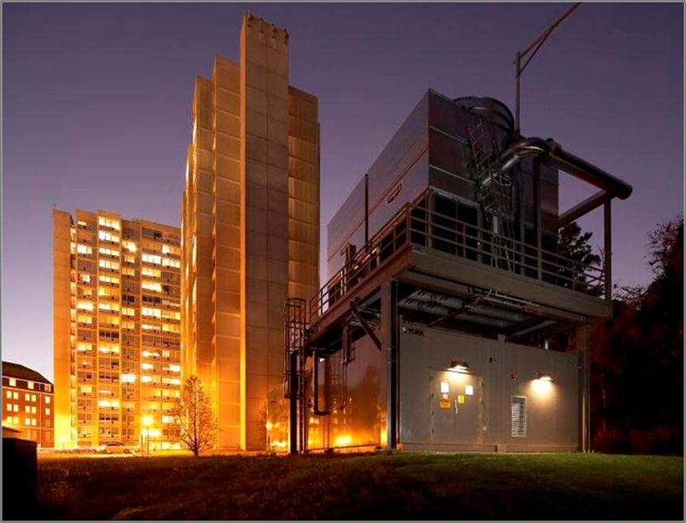
Flo Fab Enrgistx Modular Packaged Solution

Slide 29
Types of Packaged Plants
Temporary Cooling Plant
  Solidly Constructed rigid, riggable, reusable plant
  Variable Primary or Constant Volume Comes complete with Cooling Tower Skid
  Single Chiller in one module
  Screw and Centrifugal Chillers
  Primary design consideration is portability

Slide 30
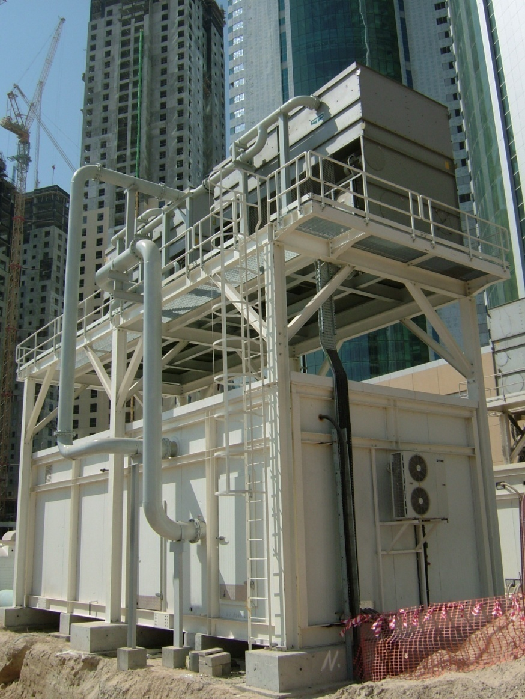
Types of Packaged Plants
- Rental / Temporary Cooling Plants
Moved from project to project
No secondary pumps needed
1,220 TR

Slide 31
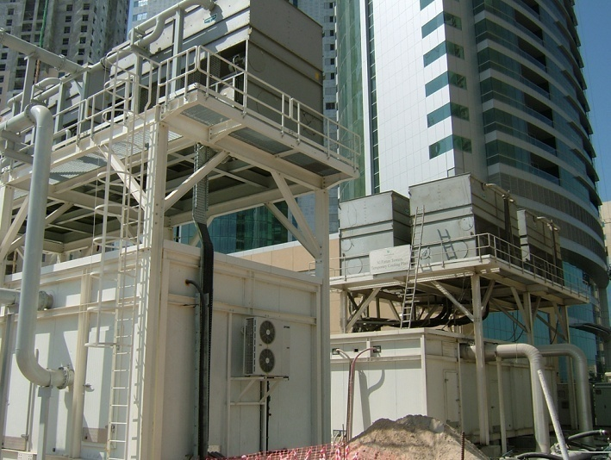
Types of Packaged Plants
- Rental / Temporary Cooling Plants

Slide 32
Types of Packaged Plant
Permanent Cooling Plant
  Solidly Constructed Rigid, riggable, permanent plant
  Variable Primary or Constant Volume Comes complete with Cooling Tower Skid
  Single or Multiple Chillers
  Screw and Centrifugal Chillers
  Primary design consideration is efficiency & ease of maintenance

Slide 33

Types of Packaged Plants
- Permanent Cooling Plants
SWITCH GEAR
TXFR AREA
400v CONDENSER WATER PUMP
400v CHILLED WATER PUMP
CHILLER & PUMP, ROOM, MCC AND MT ROOMS ARE AIR CONDITIONED
Chiller Module
Notes:
ANOTHER VIEW WITH SEPARATE AREAS HIGHLIGHTED

Slide 34
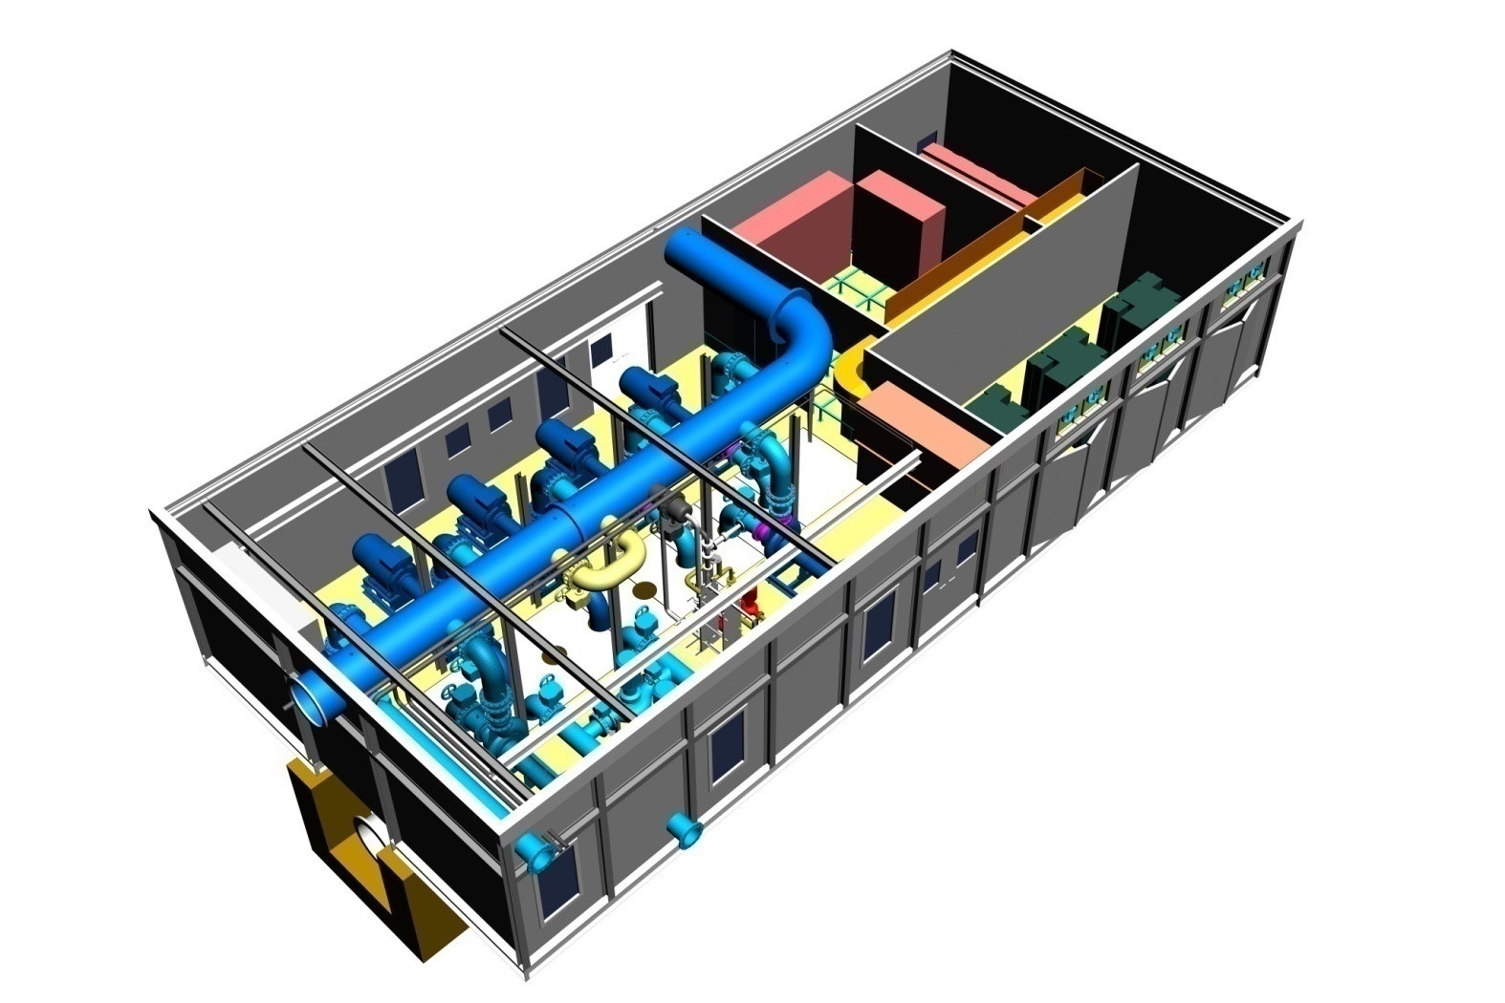
Secondary Distribution Module – Capable of Pumping 32,000TR at 9K
Types of Packaged Plants
- Permanent Cooling Plants
11kV SW/GEAR
400v MCC & VSD AREA
11kV / 400v TXFR AREA
PUMP ROOM & MCC AIR CONDITIONED
400v CH/W PUMPS W/ VSD

Slide 35
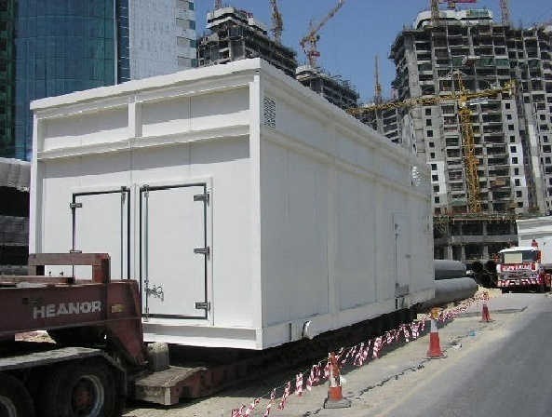
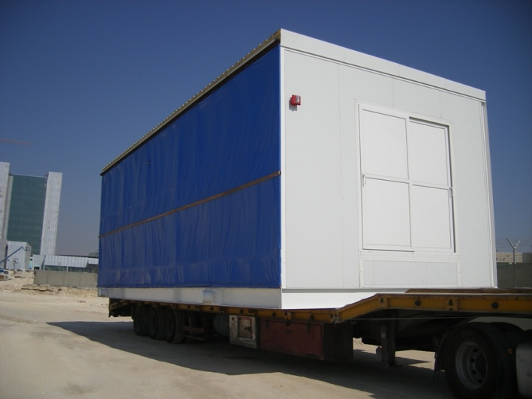
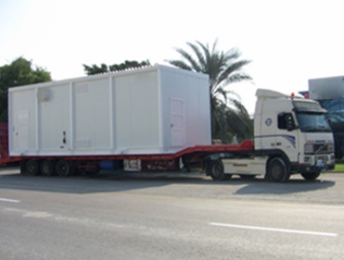
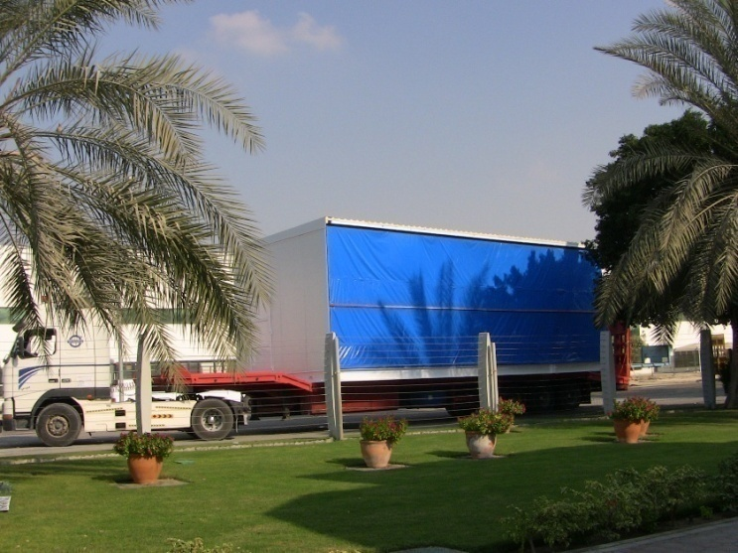
Transportation

Slide 36
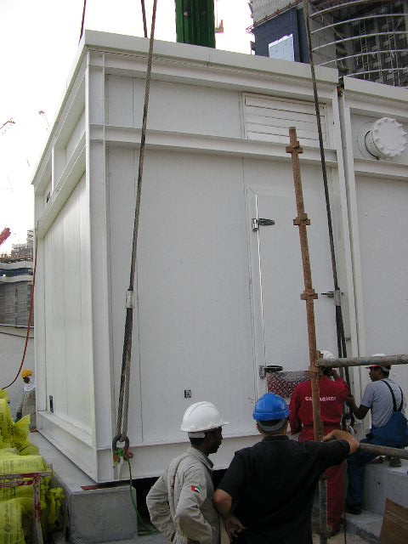
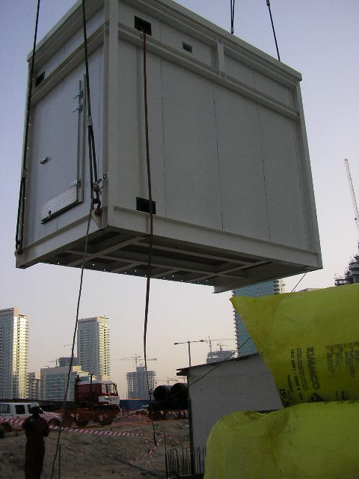
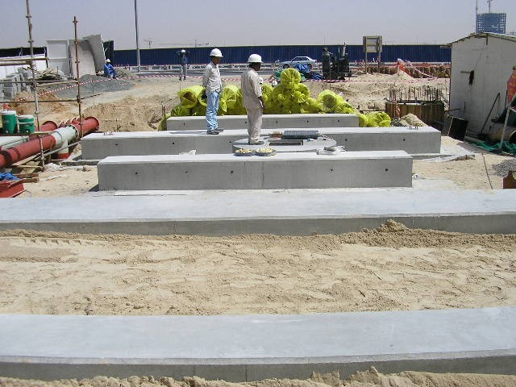
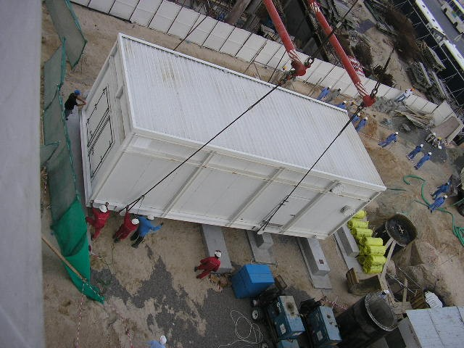
Delivery
Strip Foundations prepared
Two Section Assembly

Slide 37




Shipping Split
For module lengths > 12m
Notes:
37

Slide 38
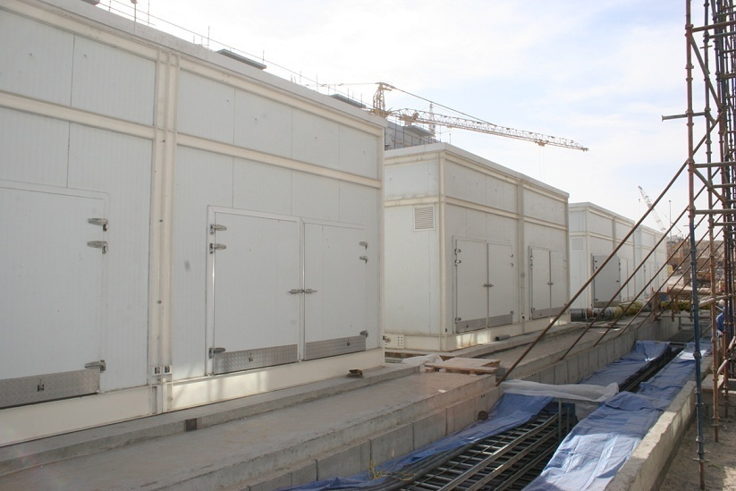
50,000TR Permanent Packaged Plant
Notes:
Each of the plants shown above are 5,000TR.
Total plant when finished will be 50,000TR
All that is required is a concrete base. All tie-ins, mechanical and electrical on this modular design are on one end.
The module comes in three sections

Slide 39
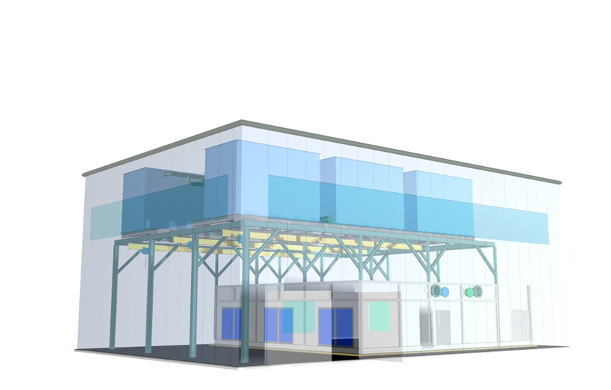
Assembly Graphic
Solutions for Multiple Chiller Systems…

Slide 40
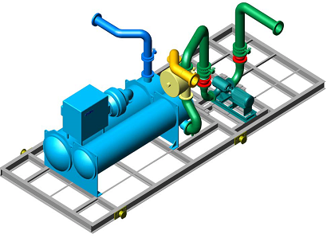
Maintenance Enhancements
(available options)
Marine Water Boxes at pipe connection ends
Sliding Water Box Access Doors
Automatic Condenser Tube Cleaning System
Condenser Water Side-stream Filtration
Lifting Gantries
TO BE UPDATED

Slide 41




Maintenance Enhancements :
Chiller Tube Service Access
Notes:
41

Slide 42

Overhead Gantry and Chain Pulley Block
Maintenance Enhancements :
Pump removal Design
Notes:
42

Slide 43
What we normally do NOT offer !!
All civil works including foundation, cable trenches, water tanks etc.
Raised platform/structure for Cooling Tower Skid in case it is not placed above the Chiller Module.
Medium voltage power connection including termination to incomer section of chiller starter panel
Low voltage power connection including termination to incomer section of packaged plant LVMCC panel
All electrical power & control cabling external to the plant
Grounding arrangement including earth strip & earth pit.
TO BE UPDATED

Slide 44
What we normally do NOT offer !!
All pipe work external to the plant
Makeup, drain and overflow connections to cooling towers
Flushing & chemical cleaning of pipe work
Dosing chemicals for condenser & chilled water treatment
System water charging (condenser & chilled water)
Local Authority coordination and approvals
Temporary power & water for site related work

Slide 45



Delivery

Slide 46



Slide 47


Slide 48



Slide 49




EXTERNAL VIEW
10 m
4.3 m
SITE LAYOUT
22 m

Slide 50






Slide 51







Slide 52



Slide 53





Slide 54





Slide 55


Slide 56


How it look like inside a shelter ?

Slide 57

Complete assembly with Shelter Works enclosure

Slide 58

Enclosure installation on skid package

Slide 59

Special package delivery

Slide 60

How to rig equipment

Slide 61

Industry leading – 25-year Warranty
Exclusive FiberBeam™ and
FiberWrap ™ Technology
Built to highest standards
Superior responsiveness and attention
to detail in all phases of a project.

Slide 62

How it look like in the field outside the building ?
* How it look in the field outside the building.

Slide 63



Enclosures

Slide 64
Explanation Videos…
https://youtu.be/6RszUZjqarY
https://youtu.be/rEgjRUsB8jM

Slide 65
Thank You for
Your participation!
Visit our Website
www.flofab.com

